Slide 1

HOSPITAL
MANAGEMENT
SYSTEM

Slide 2
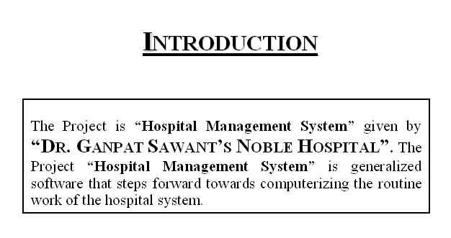

Slide 3
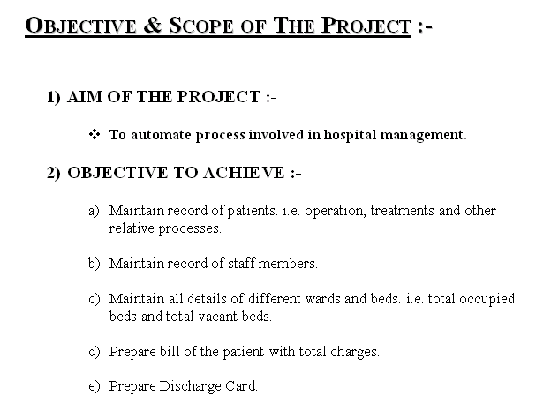

Slide 4
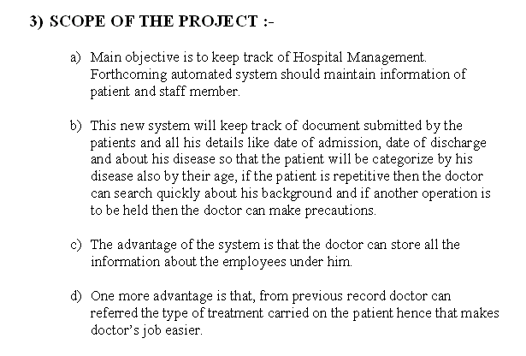

Slide 5
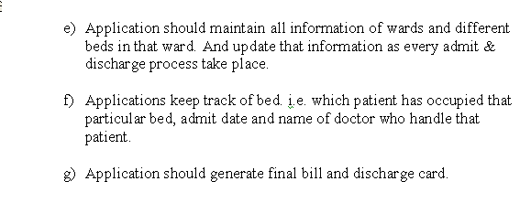

Slide 6
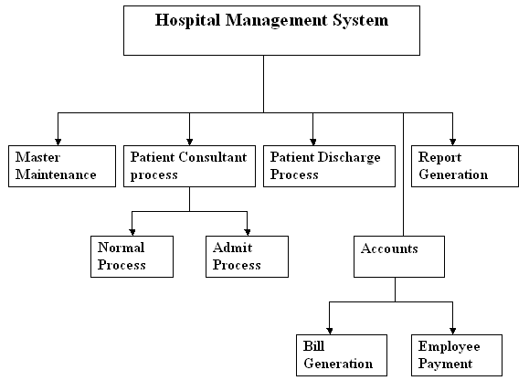
Functional Decomposition Diagram

Slide 7
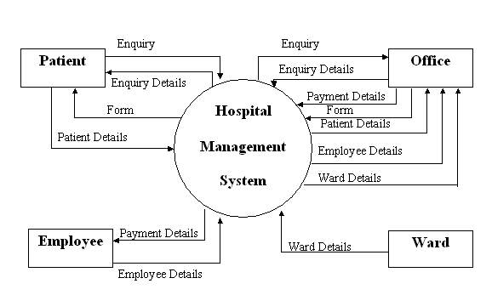
Context Level Diagram

Slide 8
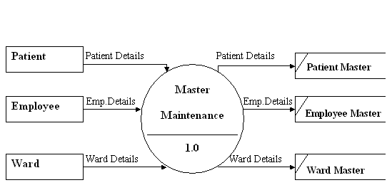
Data Flow Diagram1.0

Slide 9
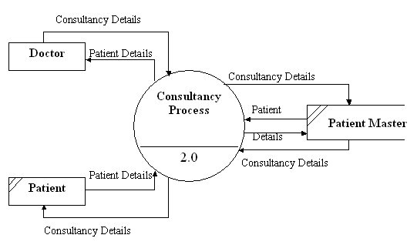
Data Flow Diagram 2.0

Slide 10
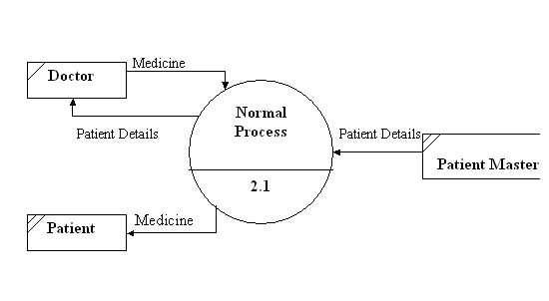
Data Flow Diagram 2.1

Slide 11
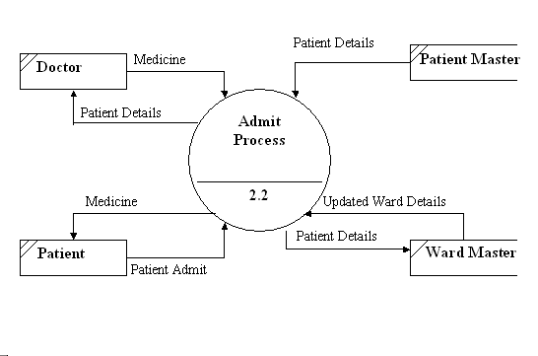
Data Flow Diagram 2.2

Slide 12
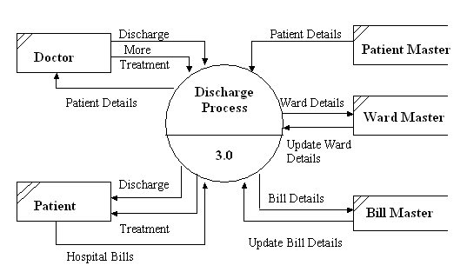
Data Flow Diagram 3.0

Slide 13
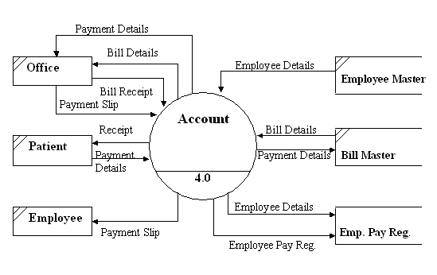
Data Flow Diagram 4.0

Slide 14
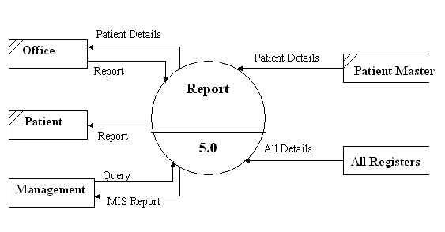
Data Flow Diagram 5.0

Slide 15
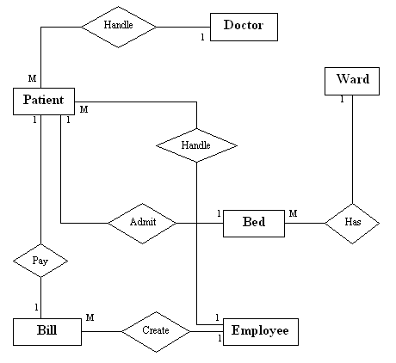
E-R Diagram

